Slide 1

StartUP
Sprinternship Data Analysis
Notes:
Julian

Slide 2
Agenda
Introduction
Analysis of Instagram data
StartUP FIU and competitors
Analysis of LinkedIn data
Analysis of Program/Event Data
Survey Feedback
Recap and Q/A
Notes:
Julian

Slide 3

Problem Statement
What can StartUP FIU do to increase engagement and rate of activations?
Notes:
Hal

Slide 4
Problem Statement
What can StartUP FIU do to increase engagement and rate of activations?
# followers who interact with posts
Measured using likes
Notes:
Hal

Slide 5
Problem Statement
What can StartUP FIU do to increase engagement and rate of activations?
# attendees who sign up for our long-term programs
Notes:
Hal

Slide 6

Focused Questions
Which events receive the most engagement on our social media?
What events lead to activations?
Notes:
Theo

Slide 7


Our Data
Instagram and LinkedIn analytics
Event and program attendance sheets
Notes:
Theo

Slide 8
Tools Used
Algorithms:
Linear Discriminant Analysis (LDA)
Non-Negative Matrix Vectorization (NMF)
Tools:
GenSim,
SciKit Learn
PyLDAvis
VADER Sentiment Analysis
Notes:
theo

Slide 9
Instagram Data
Notes:
Julian

Slide 10
Guiding Question
Which events are most engaged with on our social media?

Slide 11
Recommendations
Increase frequency for programs where students collaborate and compete in groups
Increase awareness of Hacker Nation
Notes:
Julian

Slide 12
5 Main Types of Posts
(According to LDA Machine Learning Algorithm)
1. Competitions and prizes
2. Hacker Nation
3. Student entrepreneurship
4. Events and networking
5. Miscellaneous
Notes:
Julian

Slide 13
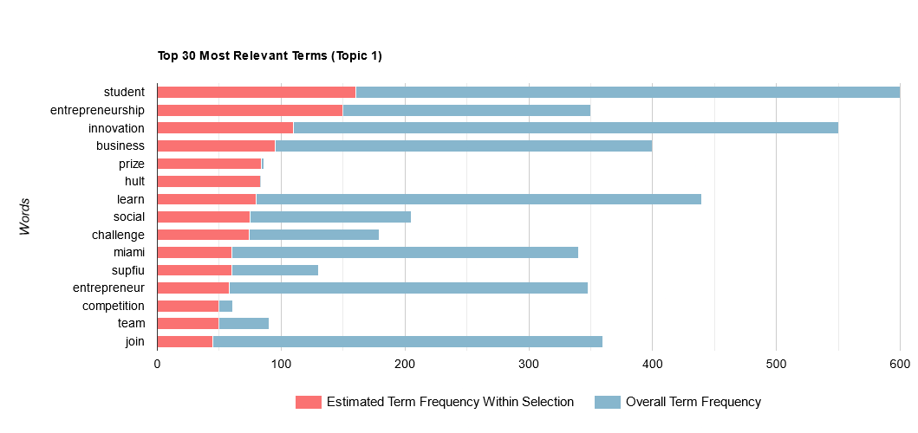
Challenges and Competitions with a Prize

Slide 14
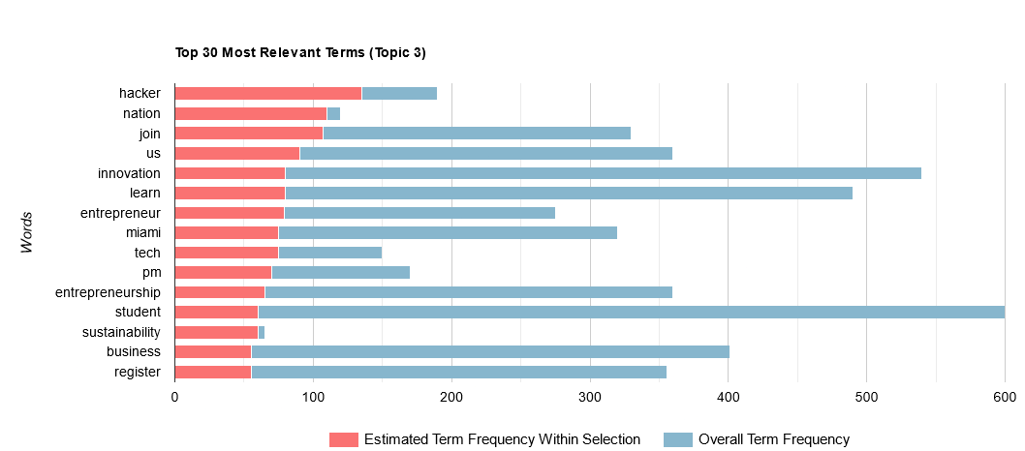
Hacker Nation
Notes:
Julian

Slide 15
Other Similar Incubators
Notes:
Dorreen

Slide 16

Guiding Question
What are other startup incubators doing that is working for them?
Notes:
Dorreen

Slide 17

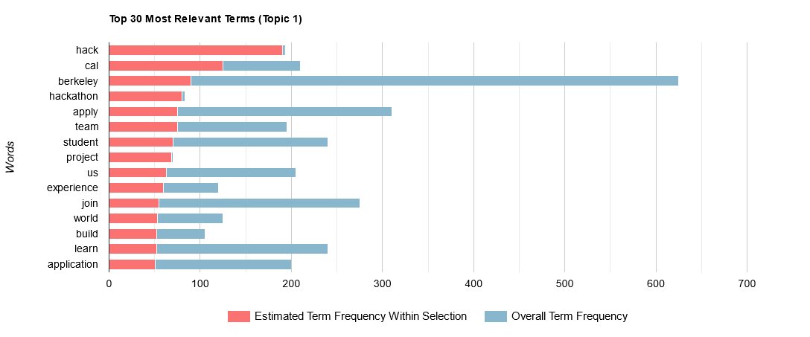
Challenges
Competitions with a prize

Slide 18

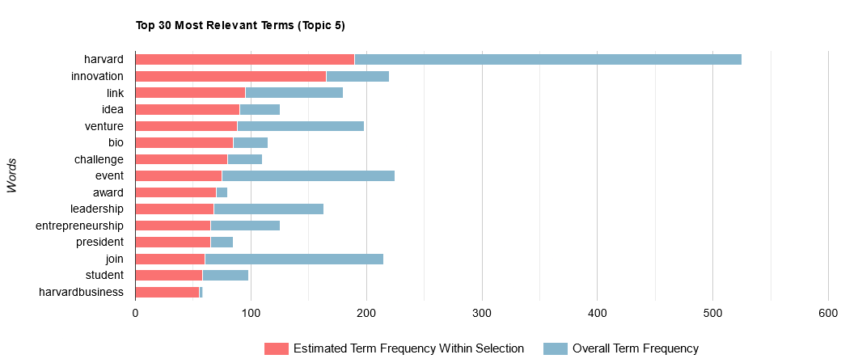
Challenges
Competitions with a prize

Slide 19
Key Takeaways
Berkeley and Harvard ➔ similar to us
Promote activities such as:
Pitch contests, hackathons, business plan contests, design sprints
Community collaboration and competition
Motivate students to increase conversion
Notes:
Dorreen

Slide 20
LinkedIn Data
Notes:
Frank

Slide 21
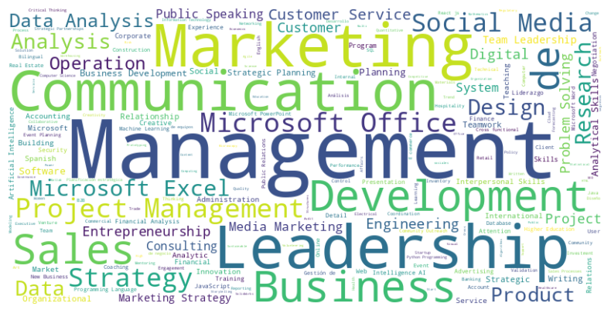
LinkedIn Follower Skill Sets
Notes:
Frank

Slide 22
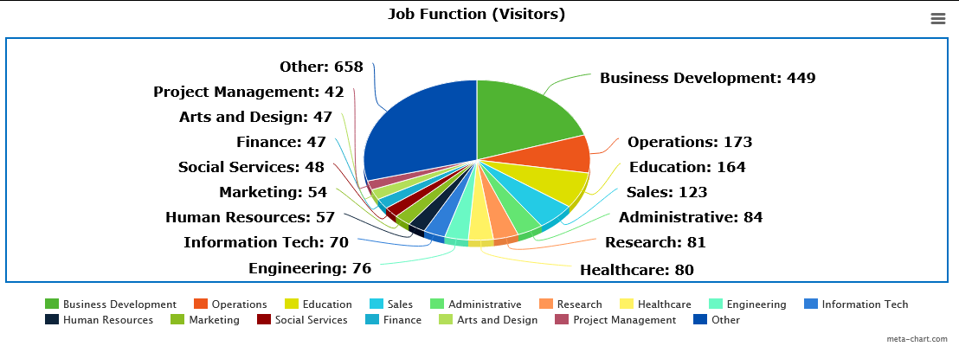
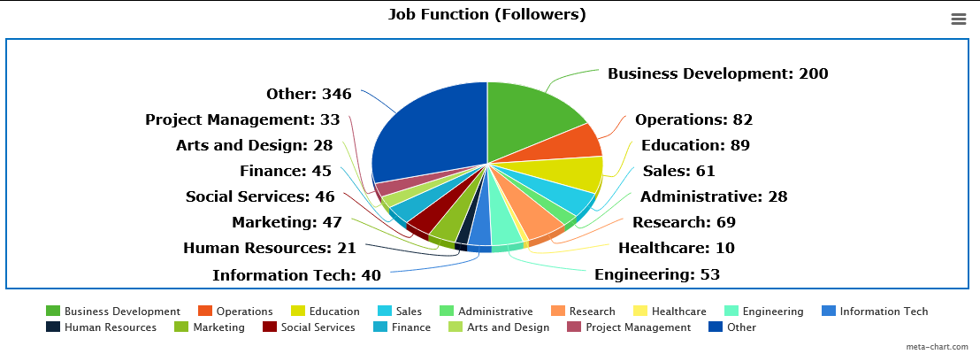
Notes:
Frank

Slide 23
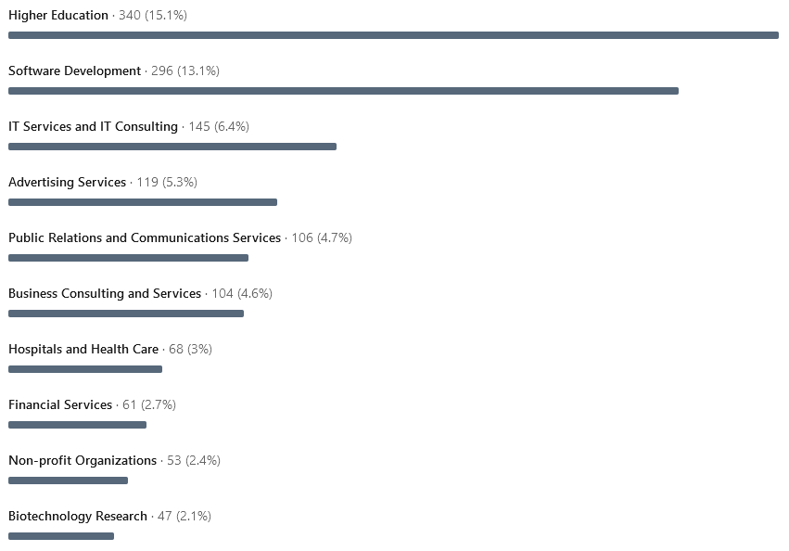
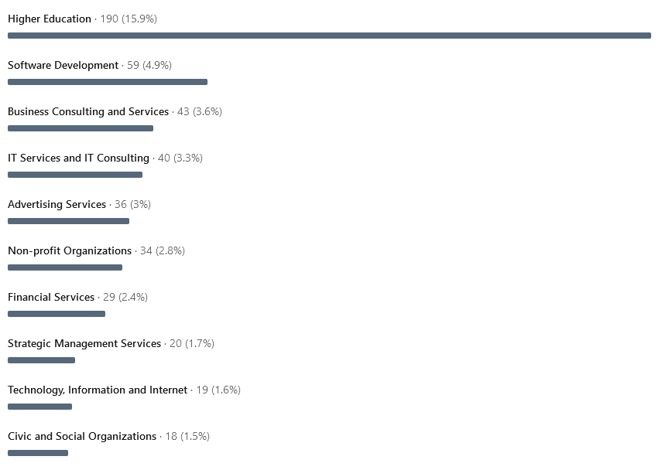
Top 10 Most Common Job Industries
Visitors
Followers
Notes:
Frank

Slide 24
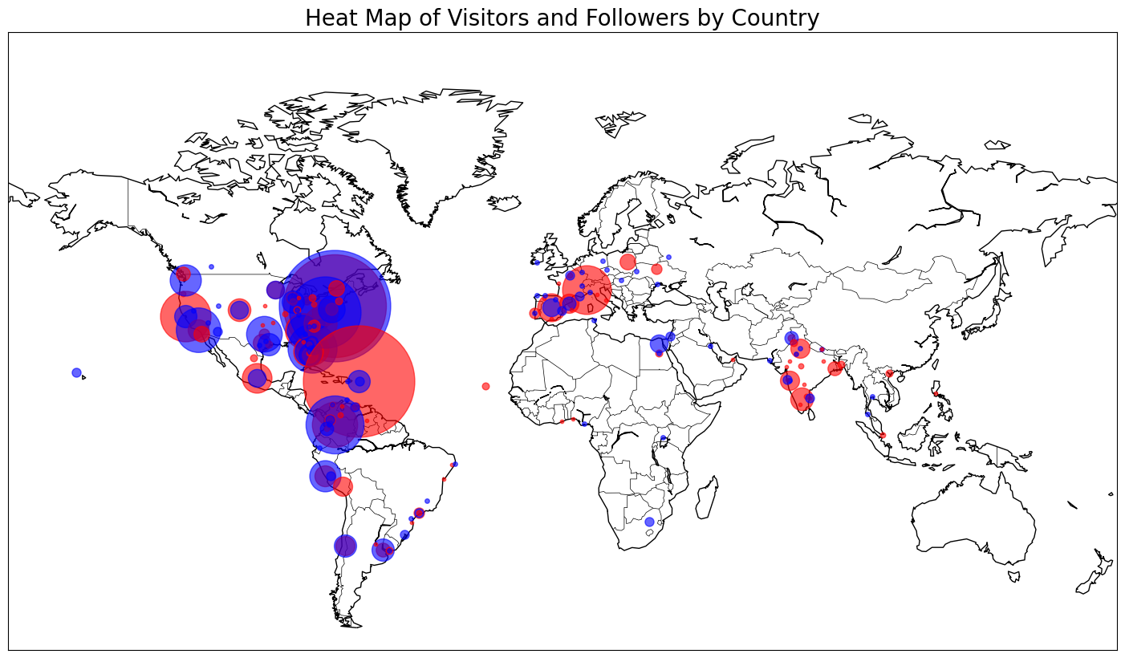
Visitor Only Follower Only Both
Miami: 1384 Visitors, 762 Followers
Notes:
Frank

Slide 25
Key Data Findings
Most followers work in business and technology.
Majority of followers are in the higher education sector.
Engagement predominantly from the US, South America, Western Europe and India.
Notes:
Julian

Slide 26
Recommendations
Focus on attracting business and technology students
Target advertisement, events, and programs towards undergrads
Leverage international students
Collaborate with ISSS
Notes:
Julian

Slide 27
Event Data
Notes:
Theo

Slide 28
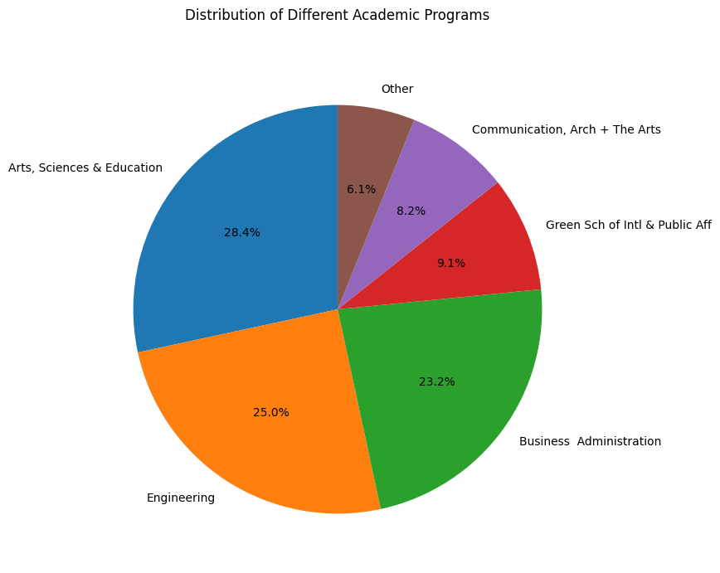
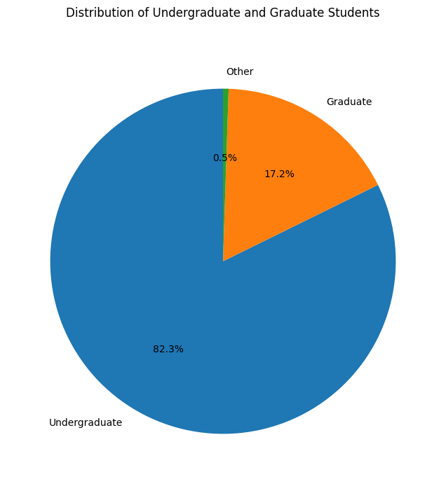
Notes:
Dorreen

Slide 29
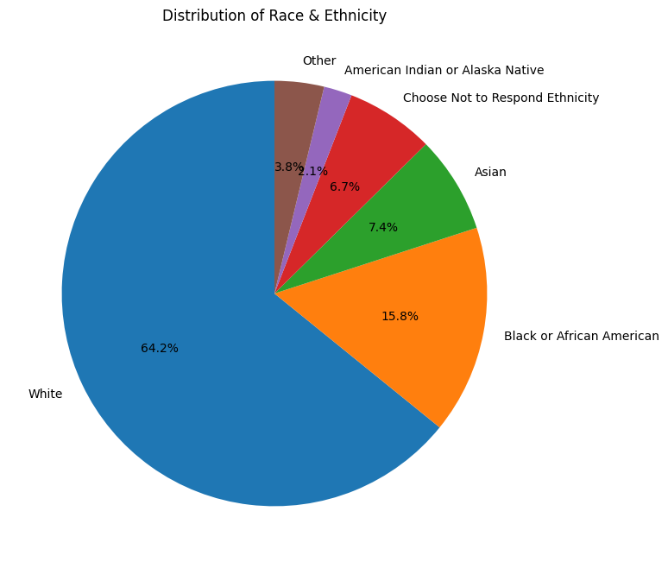
29.7% Non-Hispanic
70.3% Hispanic
52.2% Male
47.7% Female
Notes:
Dorreen

Slide 30
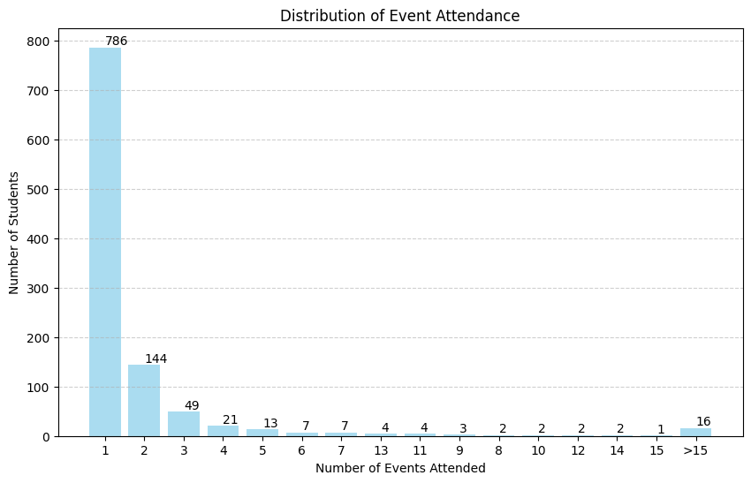

Slide 31
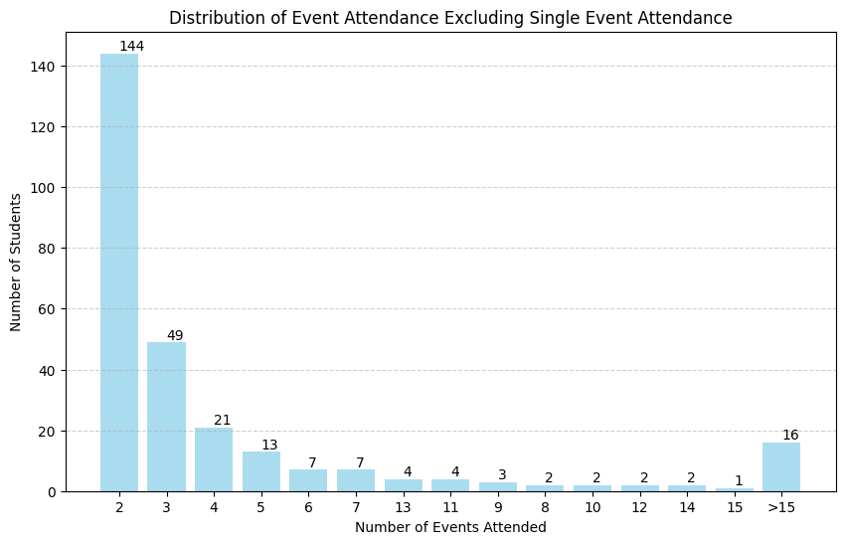
Notes:
Theo

Slide 32
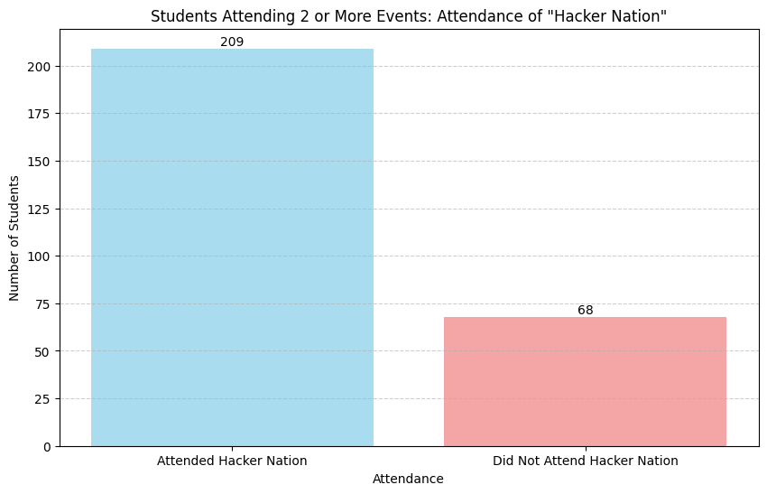
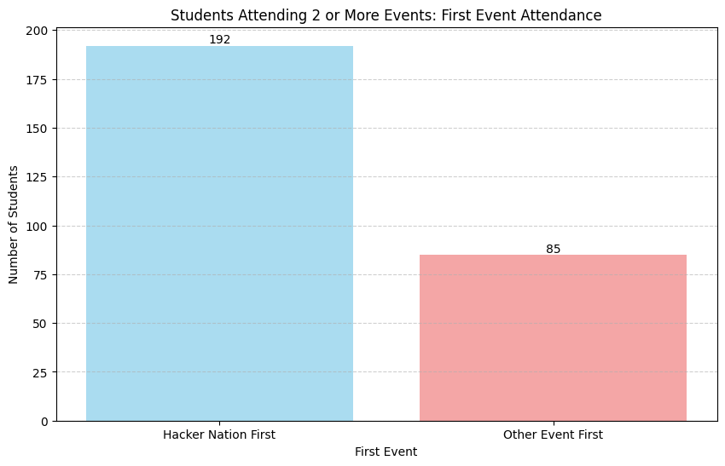
Attendees of 2+ Events: Attendance of “Hacker Nation”
Attendees of 2+ Events:
First Event Attendance
Notes:
Theo

Slide 33
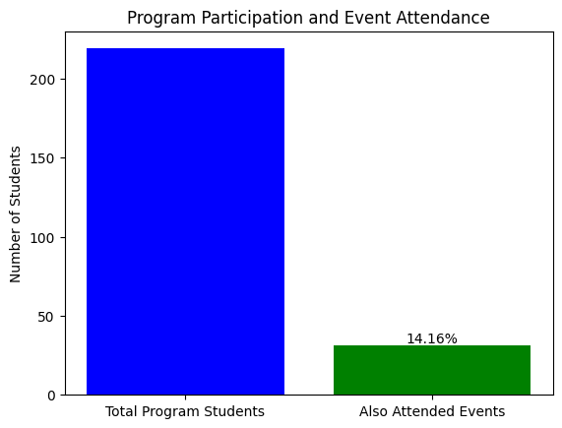
Notes:
Theo

Slide 34
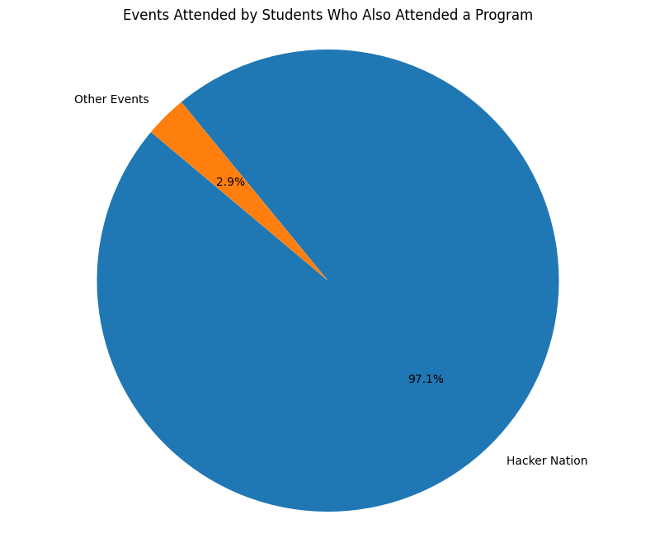
Events Attended by Program Participants
Notes:
Theo

Slide 35
Recommendations
Focus on people already attending programs
Convert event-goers into program-goers
Notes:
Theo

Slide 36
1. Focus on People Already Attending Programs
Gather feedback to enhance the program to their needs
Encourage peer referrals
Notes:
Theo

Slide 37
2. Convert Event-goers to Program-goers
Link events to programs in terms of content or benefits
Create a progression pathway from attending events to signing up for programs
Notes:
Theo

Slide 38

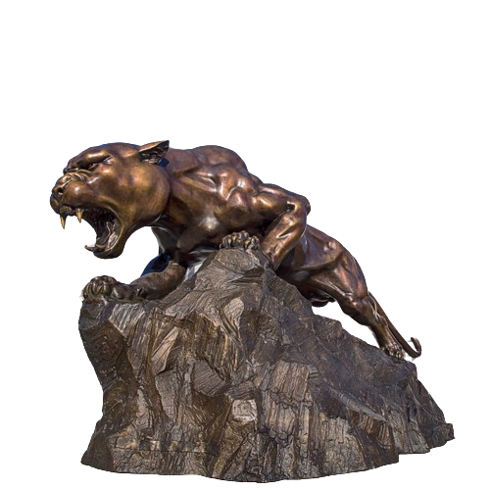
2. Convert Event-goers to Program-goers
Include brief presentations or info sessions about the available programs
Position HN as the introductory event to programs
Feature alumni from programs and HN
Notes:
Julian

Slide 39
2. Convert Event-goers to Program-goers
FIU Creator’s program
Incentives for participation (raffles, giveaways)
Automated email sequences
Newsletters
Surveys and Feedback Forms
Notes:
Julian

Slide 40
Pilot Survey Feedback
Notes:
Hal

Slide 41

Pilot Survey
Ran a survey with 25 participants
Data gathered over the course of 72 hours
Platform used: Qualtrics

Slide 42

10 15
1 < 18 y/o
20 18-24 y/o
2 25/34 y/o
2 35-44 y/o
Notes:
Hal

Slide 43
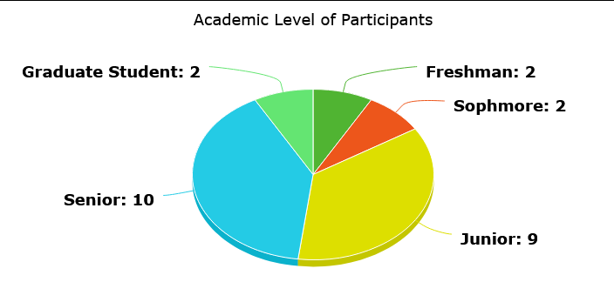
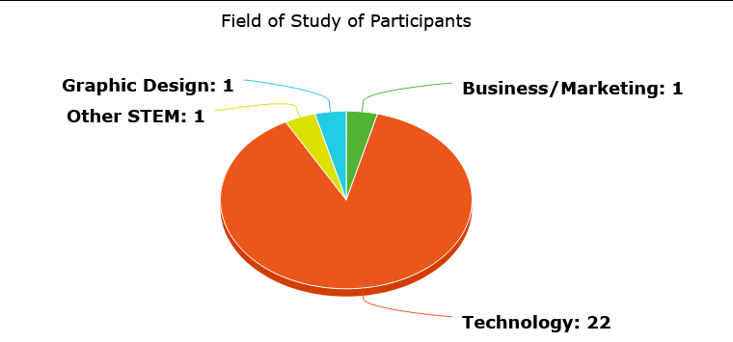

Slide 44
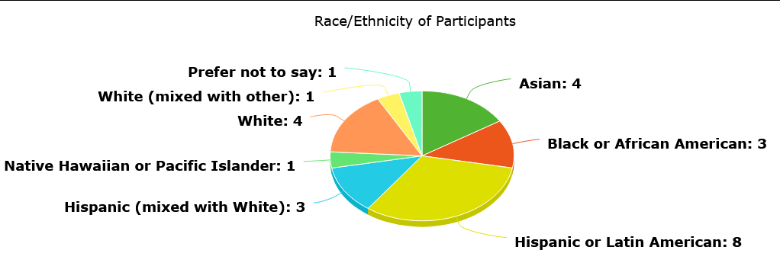
6 Domestic students
19 International students
Notes:
Hal

Slide 45
Hearing About Events
10 Emails/newsletters
3 Posters/signs around campus
6 Social media
6 Word of mouth
Notes:
Hal

Slide 46

Factors That Influence Attendance
Interest in what the event is about
Socializing/ networking
Food and merchandise
Runner-ups:
4. Skills/advice
5. Honors College Points

Slide 47
68%
23%
76%
have not taken advantage of StartUP's services
have attended an event hosted by StartUP
have interest in entrepreneurship

Slide 48
Key Data Findings
Attendees hear about events most from emails/social media and word of mouth
Most interested in career and diversity oriented events
High priority placed on networking for events
Notes:
Hal

Slide 49
Recommendations
Make StartUP FIU more accessible to newcomers
Targeted advertising for events (+ context)
Offer resources for career development
Provide food and/or merchandise at events
Notes:
Hal

Slide 50
Closing Thoughts
Notes:
Theo

Slide 51
Sprinternship Summary
Gathered & cleaned data
Identified correlations between engagement and keywords
Analyzed attendance patterns
Created survey
Analyzed data to create our conclusions
Notes:
Julian

Slide 52
Recap of Recommendations
Leverage Hacker Nation’s popularity
Adapt programs to attract event-goers
Enhance their value for current participants
Highlight alumni success stories
Heighten social media presence
Post about student challenges, competitions, and prizes
Utilize FIU Creator’s program
Incentives for participation (raffles, giveaways)
Utilize email lists / newsletters
Notes:
Julian - Mention of Harvard alumni page

